Slide 1
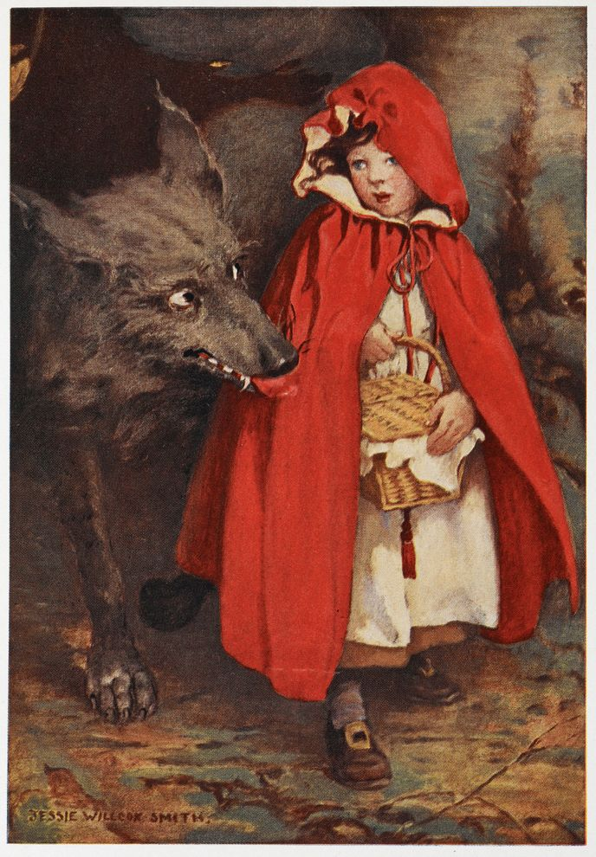
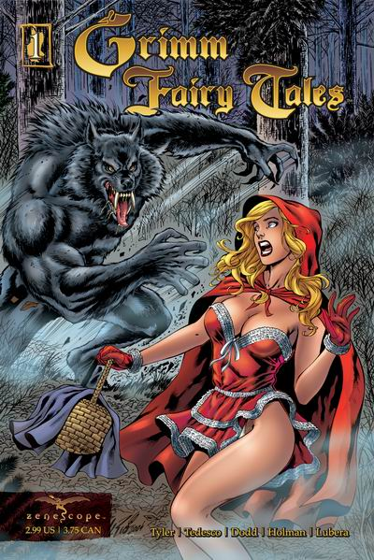
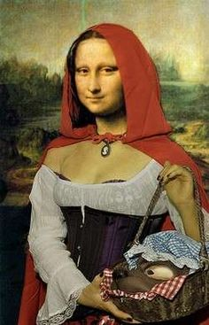
Fairy Tales:
Postmodern Adaptations

Slide 2
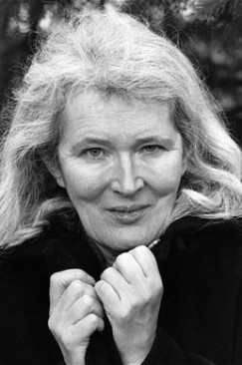
Angela Carter
1940-1992
English novelist, journalist
Wrote many novels and stories
Translated fairy tales
Wrote children’s books
Associated with feminism, postmodernism, magical realism

Slide 3
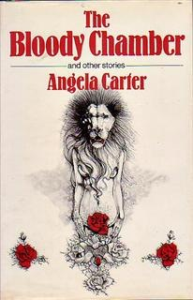
The Bloody Chamber & Other Stories
One of Carter’s best-known, most-praised works
Published 1979
Adapts fairy and folk tales including:
Bluebeard
Beauty and the Beast
Little Red Riding Hood
Puss in Boots

Slide 4
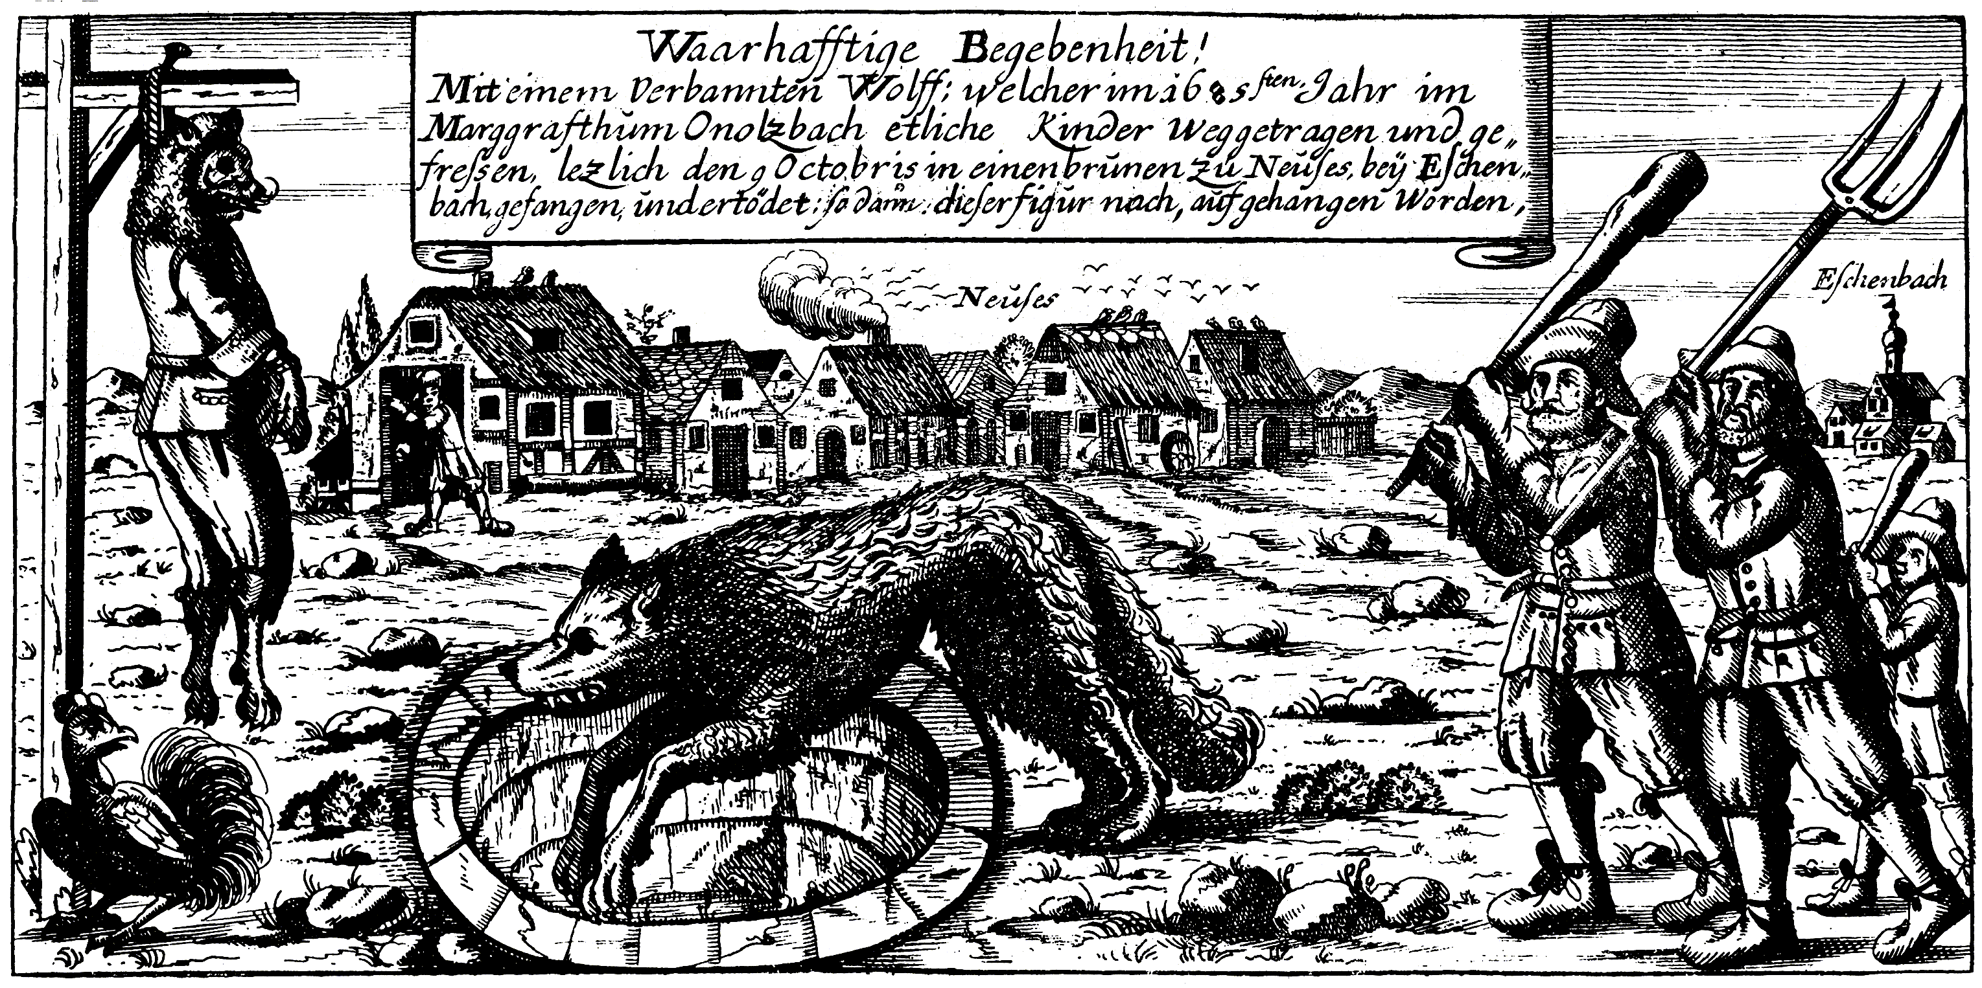
Angela Carter, “The Werewolf”

Slide 5
Signal Question
Compare the characters in Carter’s “The Werewolf” with the Grimms’ “Little Red Cap.” How does Carter change the familiar characters/types?
What/who is the ‘monster’ in this text?
How should we feel about “the child”? Do you feel sympathetic toward her? Why/why not?
Is she brave? Cunning? Daring? Cold? Manipulative? Cruel?

Slide 6
Reflection
Write for five minutes:
Look back at Carter’s stories. How would you compare the language—the style and tone—to that of the Brothers Grimm? What are some of the differences?

Slide 7
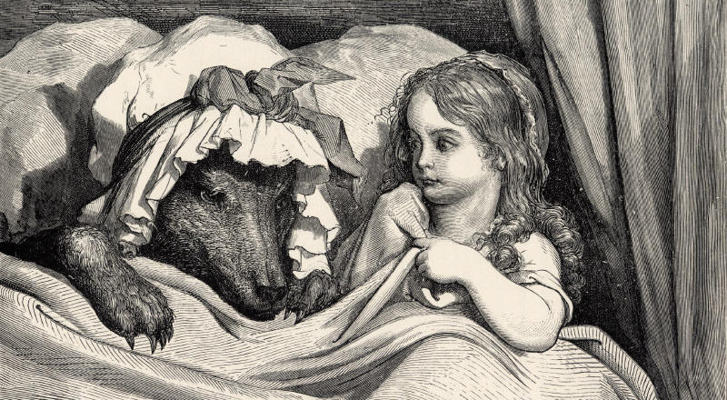
Angela Carter, “The Company of Wolves”

Slide 8
Angela Carter, “The Company of Wolves”
What is/are the ‘monsters’ in this text?
How are the wolves and werewolves depicted?
How would you compare the style of this tale with traditional fairy tales like the Grimms’?
How is the ‘child’ or LRR figure depicted?
How does Carter’s ending differ from the Grimms’ or Perrault’s?

Slide 9
Close Read
“Those slavering jaws; the lolling tongue; the rime of saliva on the grizzled chops – of all the teeming perils of the night and the forest, ghosts, hobgoblins, ogres that grill babies upon gridirons, witches that fatten their captives in cages for cannibal tables, the wolf is worst for he cannot listen to reason.” (Carter 111)
“Fear and flee the wolf; for, worst of all, the wolf may be more than he seems.” (Carter 111)

Slide 10
Close Read:
“That long-drawn, wavering howl has, for all its fearful resonance, some inherent sadness in it, as if the beasts would love to be less beastly if only they knew how and never cease to mourn their own condition. There is a vast melancholy in the canticles of wolves, melancholy infinite as the forest, endless as these long nights of winter and yet that ghastly sadness, that mourning for their own, irremediable appetites, can never move the heart for not one phrase in it hints at the possibility of redemption; grace could not come to the wolf from its own despair, only through some external mediator, so that, sometimes, the beast will look as if he half welcomes the knife that despatches him.” (Carter 112)

Slide 11
Signal Question
Before its retelling of “Little Red Riding Hood,” Carter’s tale includes several shorter stories, anecdotes, and bits of legend and lore. How do these parts prepare us for the re-telling that follows? What do these parts teach us about the themes of the story?

Slide 12
Postmodernism
Brief Definition:
A late 20th-century style and concept in the arts, architecture, and criticism, which represents a departure from modernism and is characterized by the self-conscious use of earlier styles and conventions, a mixing of different artistic styles and media, and a general distrust of theories.

Slide 13
Conventions associated with “postmodern literature”
Self-conscious use of (old) styles and genres
‘Pastiche’: mixing different styles, genres, media
Parody: making fun of genre
Unreliable narrators
Fragmented forms
Irony
Distortions of time/space

Slide 14
Postmodernism in Carter
Fragmentation: different bits of story, anecdote, superstition, bits of dialogue all included under a single title
Self-conscious use of genre: adaptation of fairy tale (not very straightforward); “commonplaces of a rustic seduction” (115)

Slide 15
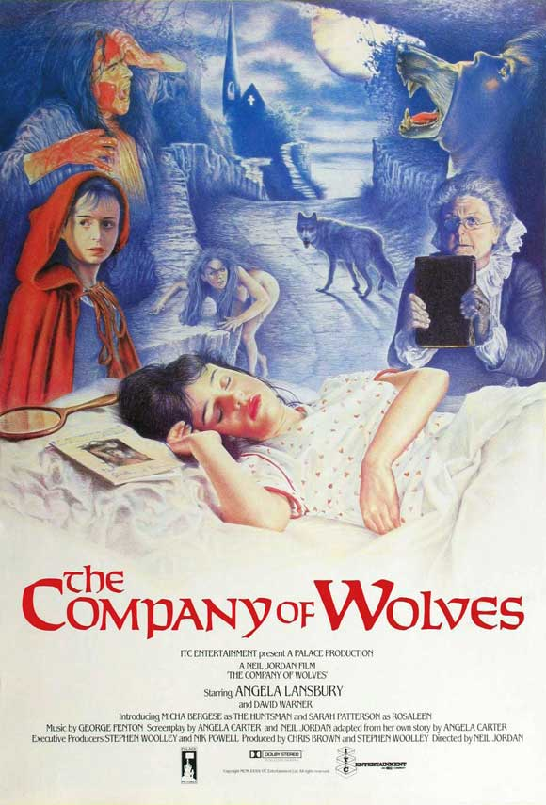
The Company of Wolves (1984)
Directed by Neil Jordan
Written by Angela Carter and Jordan
Adapted from Carter’s stories

Slide 16
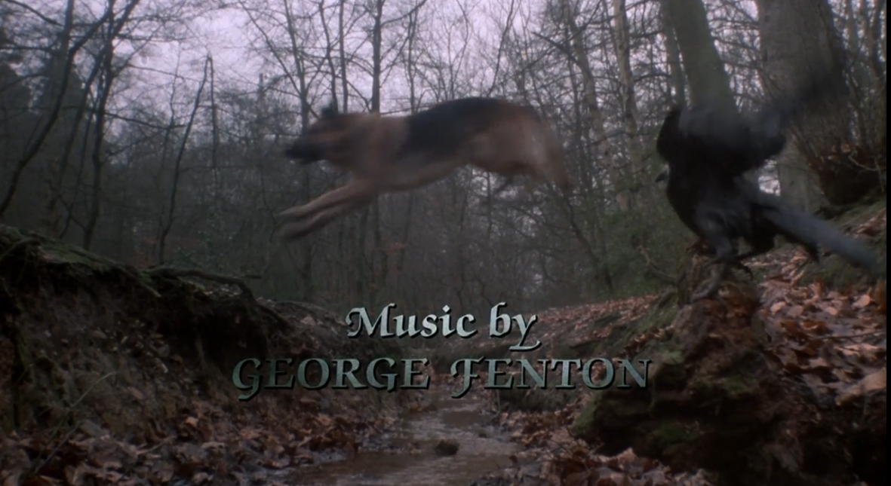
The Company of Wolves (1984)

Slide 17
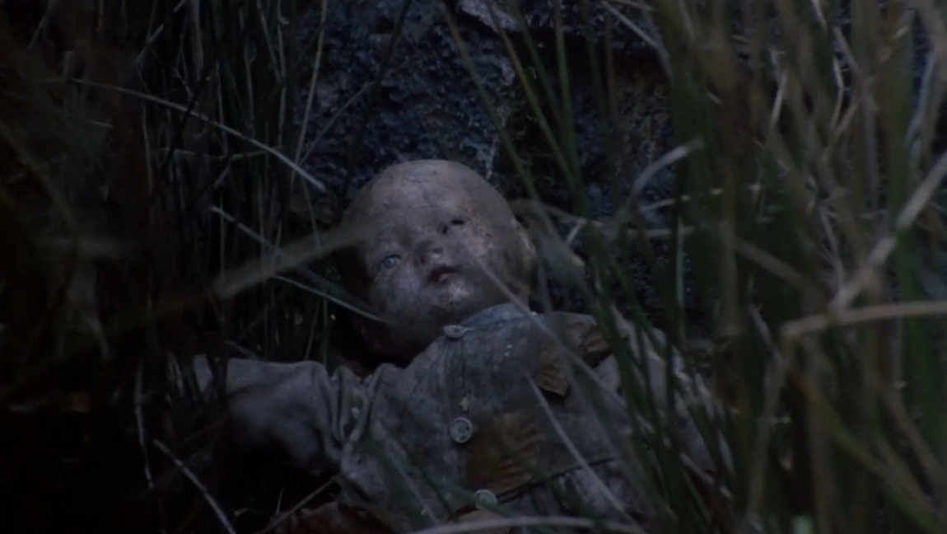
The Company of Wolves (1984)

Slide 18
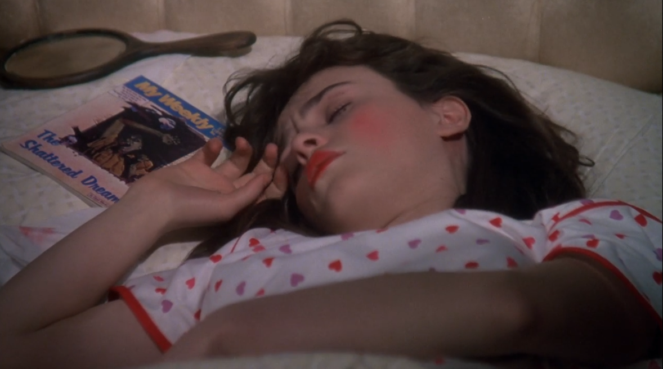
The Company of Wolves (1984)

Slide 19
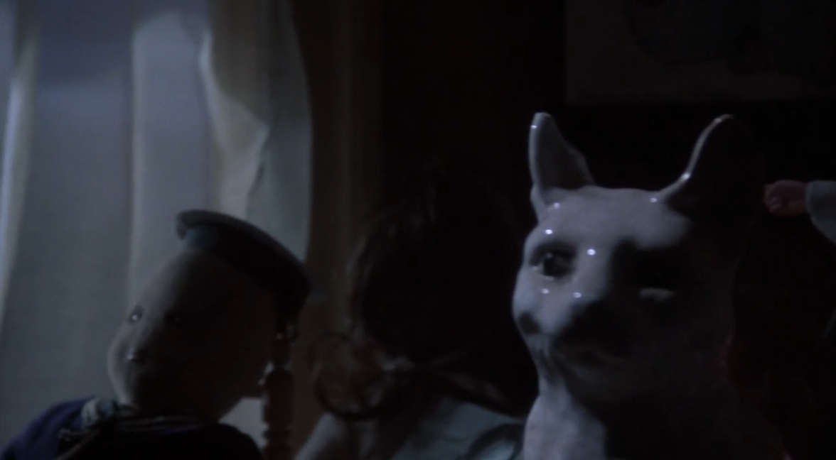
The Company of Wolves (1984)

Slide 20
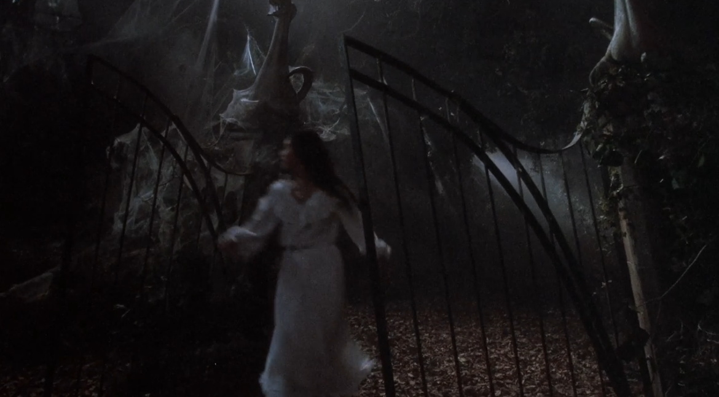
The Company of Wolves (1984)

Slide 21
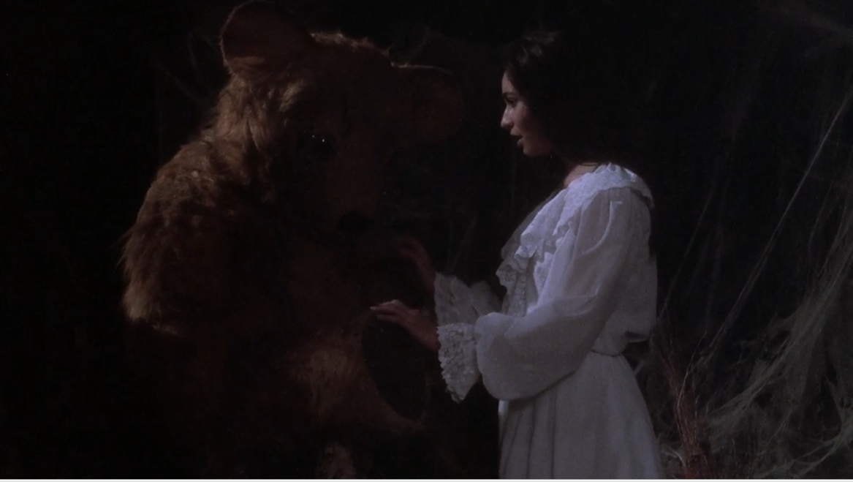
The Company of Wolves (1984)

Slide 22
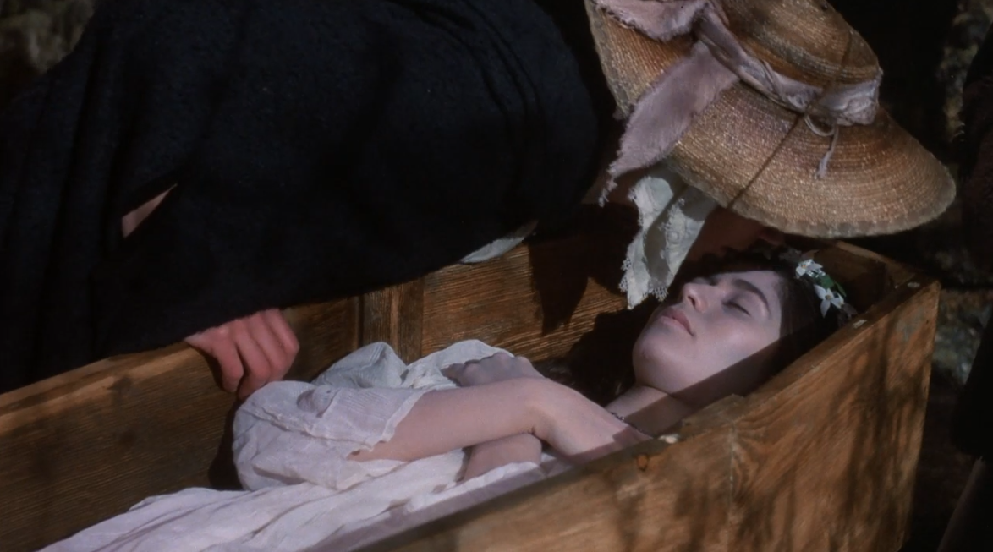
The Company of Wolves (1984)

Slide 23
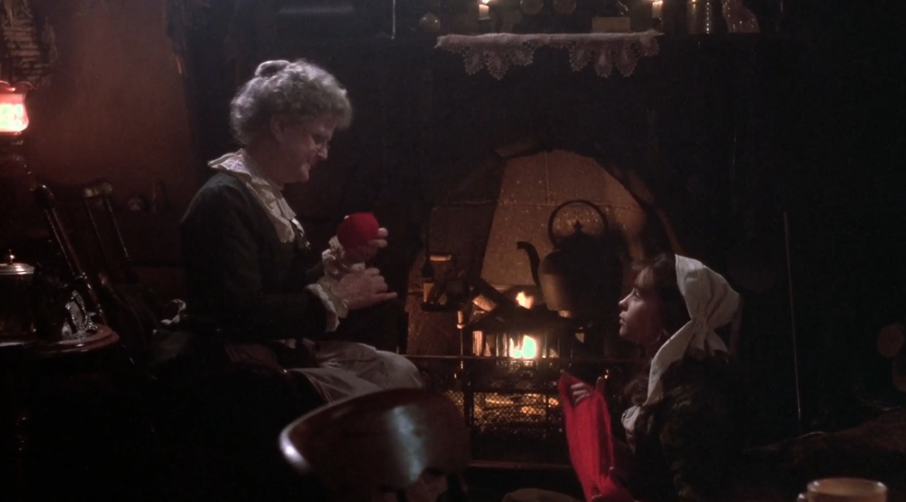
The Company of Wolves (1984)

Slide 24
Neil Jordan on his film:
"It's a film about storytelling . . . It's about the use of stories, and in the case of fairy tales, the main use is to teach young girls not to have sex with men, isn't it? . . . The Company of Wolves is about how society teaches young women to look at themselves, and what to be afraid of. It's about a girl learning that the world of sensuality and the unknown is not to be feared, that it's worth getting your teeth into.”

Slide 25
Jordan & Carter, “The Company of Wolves”
How is the ‘child’ or LRR figure depicted?
How does Carter’s (and Jordan’s) ending differ from the Grimms’ or Perrault’s?

Slide 26
FEMINIST?
“The wolves themselves are … a key to understanding this superficially puzzling film. It is of utmost importance that not all of the wolves in the film are male. [It is] is a feminist rebuke of the young woman as hapless victim — as sexual prey for a predatory male. [The ending, where Rosaleen becomes a wolf,] offers us a definitive reversal of the victim role in which Red Riding Hood and those interchangeable female horror film characters are typically cast. Thus, while it is a horror film,…The Company of Wolves does not simply play on or reinforce the sexual anxieties of its audience. Rather, it presents both sides of sexuality, both threatening and desirable, as well as a level playing field for both genders.”
—Victoria Large on The Company of Wolves

Slide 27
ANTI-FEMINIST?
Despite Carter’s association with the feminist movement, she alienated many feminists who claimed that her celebration of feminine sexuality (and pornography) merely capitulated to standards of male desire. According to critic Patricia Duncker, “Carter envisages women's sensuality simply as a response to male arousal.”

Slide 28
Signal Question
Write for five minutes on either question:
A) How do Carter’s fairy tales change or adapt the message of earlier traditional versions?
B) How would you evaluate Carter’s depiction of feminine sexuality. Would you call it feminist? Why/why not?

Slide 29
Signal Question
Write for ten minutes:
Focusing on either of Carter’s stories, describe the significance of the changes made to earlier versions of the fairy tales. In particular, what do the ‘monsters’ in Carter’s versions represent? How are they different?

Slide 30
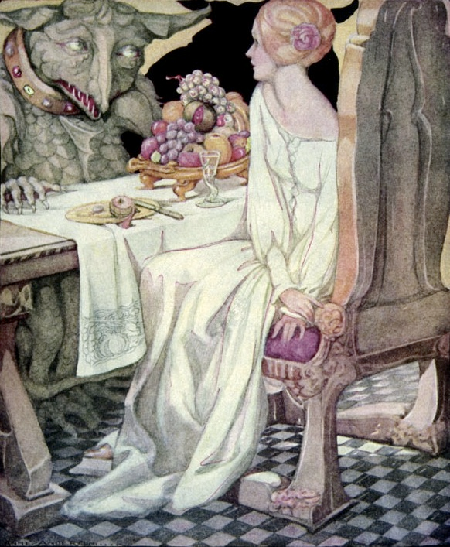
“Beauty and the Beast”
~4000 years old
First written: Gabrielle-Suzanne Barbot de Villeneuve (1740)
First published: Jeanne-Marie Leprince de Beaumont (1756)

Slide 31
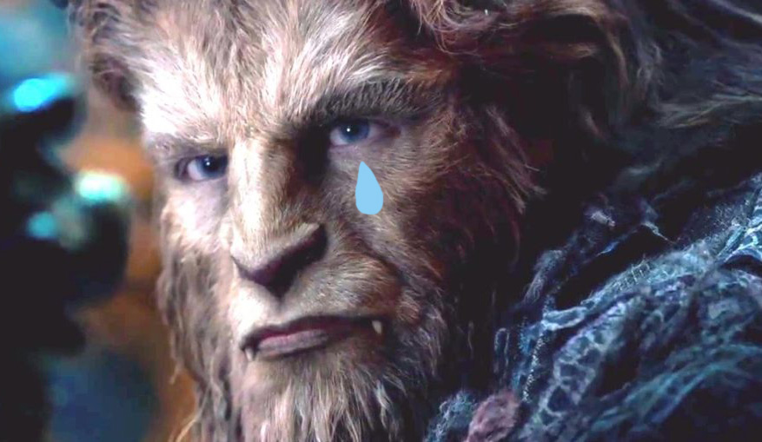
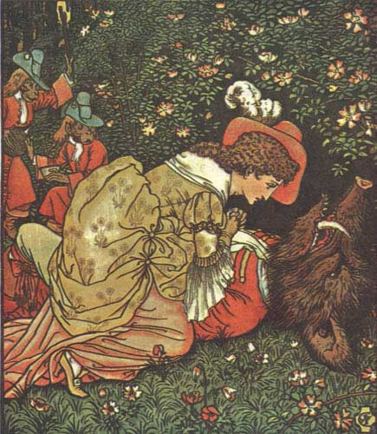
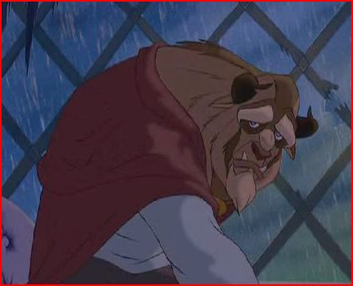

Slide 32
Signal Question
In the Disney versions of “Beauty and the Beast,” much like the early fairy tales, The Beast is—at least in part—a tragic figure, a victim. His monstrosity is a shell, a costume: his outward appearance, a temperament in need of domestication, bad manners in need of feminine correction. How would you compare him with Carter’s “Beast”? In what sense is Carter’s “Beast” monstrous? Is he, too, tragic or sympathetic?

Slide 33
Close Read
“There is a crude clumsiness about his outlines, that are on the ungainly, giant side; and he has an odd air of self-imposed restraint, as if fighting a battle with himself to remain upright when he would far rather drop down on all fours. He throws our human aspirations to the godlike sadly awry, poor fellow; only from a distance would you think The Beast not much different from any other man, although he wears a mask with a man’s face painted most beautifully on it. Oh, yes, a beautiful face; but one with too much formal symmetry of feature to be entirely human: one profile of his mask is the mirror image of the other, too perfect, uncanny. He wears a wig, too, false hair tied at the nape with a bow, a wig of the kind you see in old-fashioned portraits. A chase silk stock stuck with a pearl hides his throat. And gloves of blond kid that are yet so huge and clumsy they do not seem to cover hands.
He is a carnival figure made of papier mâché and crêpe hair; and yet he has the Devil’s knack at cards.” (53)

Slide 34
Signal Question
The narrator and heroine of “The Tiger’s Bride” compares herself with the mechanical maid, the automaton “soubrette” (a flirtatious figure in many operas) (59-60, 63). What does this comparison tell us about her position? How does the narrator characterize herself?

Slide 35
Close Read
“I knew my two companions were not, in any way, as other men, the simian retainer and the master for whom he spoke, the one with clawed forepaws . . . I knew they lived according to a different logic than I had done until my father abandoned me to the wild beasts by his human carelessness. This knowledge gave me a certain fearfulness still; but, I would say, not much . . . I was a young girl, a virgin, and therefore men denied me rationality just as they denied it to all those who were not exactly like themselves, in all their unreason. If I could see not one single soul in that wilderness of desolation all around me, then the six of us – mounts and riders both – could boast amongst us not one soul, either, since all the best religions in the world state categorically that not beasts nor women were equipped with the flimsy, insubstantial things when the good Lord opened the gates of Eden and let Eve and her familiars tumble out. . . . [I] meditated on the nature of my own state, how I had been bought and sold, passed from hand to hand. That clockwork girl who powdered my cheeks for me; had I not been allotted only the same kind of imitative life amongst men that the doll-maker had given her?” (63)

Slide 36
Close Read
“I was unaccustomed to nakedness. I was so unused to my own skin that to take off all my clothes involved a kind of flaying. I thought The Beast had wanted a little thing compared with what I was prepared to give him; but it is not natural for humankind to go naked, not since first we hid our loins with fig leaves. He had demanded the abominable. I felt as much atrocious pain as if I was stripping off my own underpelt and the smiling girl stood poised in the oblivion of her balked simulation of life, watching me peel down to the cold, white meat of contract and, if she did not see me, then so much more like the market place, where the eyes that watch you take no account of your existence.
And it seemed my entire life, since I had left the North, had passed under the indifferent gaze of eyes like hers.” (66)

Slide 37
Signal Question
How would you compare the ending of “The Tiger’s Bride” with the ending of the Disney versions (and traditional fairy tales)?
Do you notice any similarities between the endings of “The Company of Wolves” and this tale?

